Slide 1
Attention Mechanism & Transformer
Jiwon Park

Slide 2
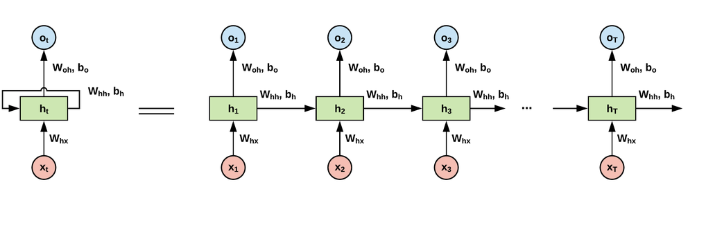
Limitations of existing RNNs
Characteristics of repeated multiplication, temporal dependence => Vanishing Gradient, Long-Term Dependency problem

Slide 3
Attention Main Idea
❌ Rather than simply processing sequences sequentially,
🌟 it dynamically reflects the entire context of the input data at once.
=> Each token of the input data learns its relevance to other elements in the entire input sequence.

Slide 4
Dynamically reflecting context
”Attend” : Consider the overall context, but focus more on the important information.
How to calculate importance? => 🌟 query, key-value pair
Calculate the similarity between Query, Key, and Value to give greater weight to important input data.
Query: Current situation given to me
Key, value : References

Slide 5
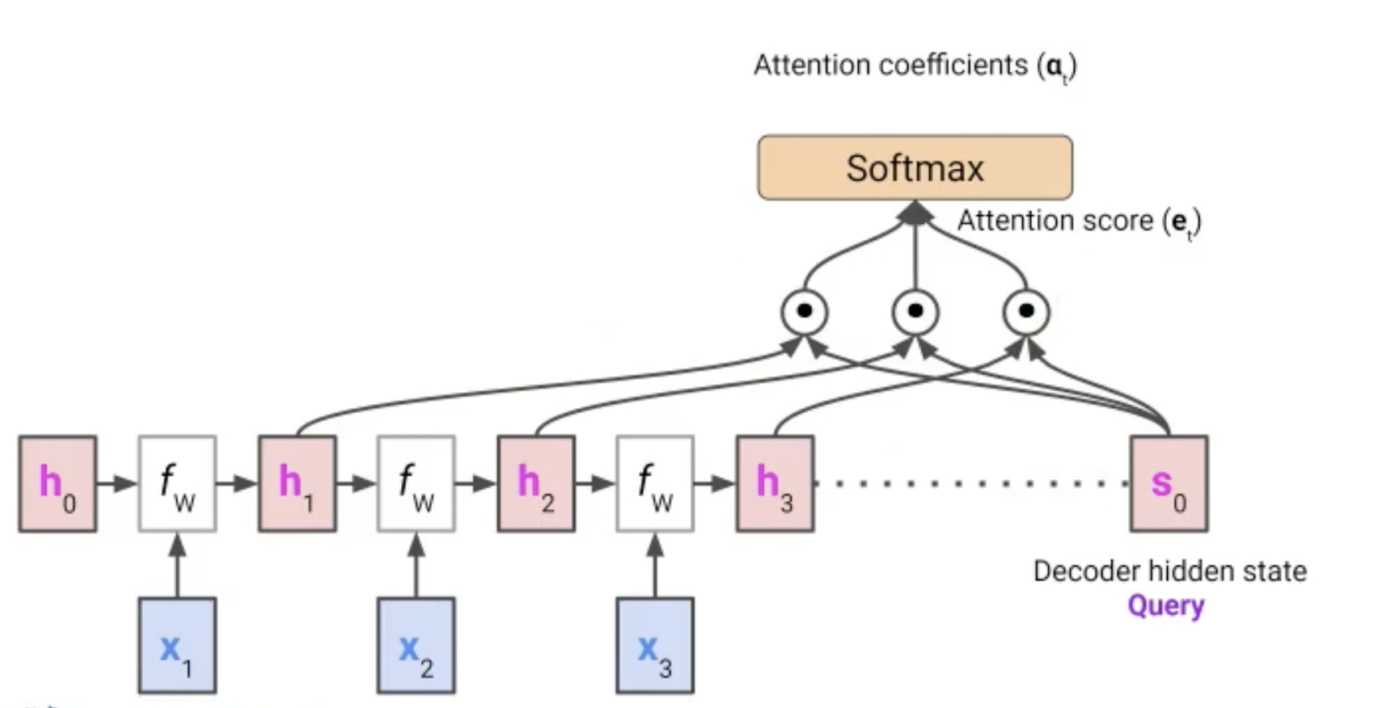
Dot-Product Attention
Query: the decoder hidden state at time t
Key: the encoder hidden states at all times
Value: the encoder hidden states at all times
First, The similarity (attention score) is calculated by taking the inner product of keys and query.
Second, Softmax normalization is performed to interpret it as a probability.
=> The computed attention coefficients indicates the importance of keys for the current query.

Slide 6
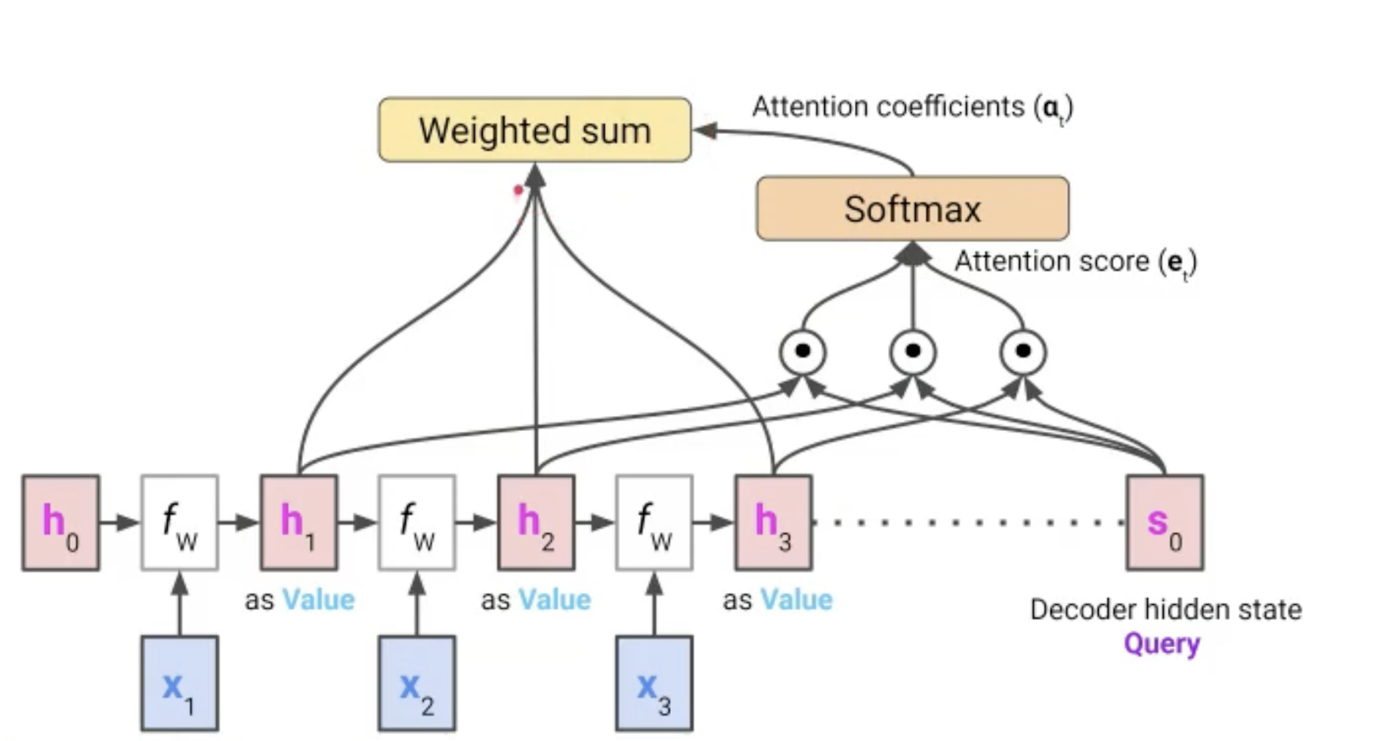
Dot-Product Attention
Therefore, these coefficients are used as weights and the value and weighted sum are performed.

Slide 7
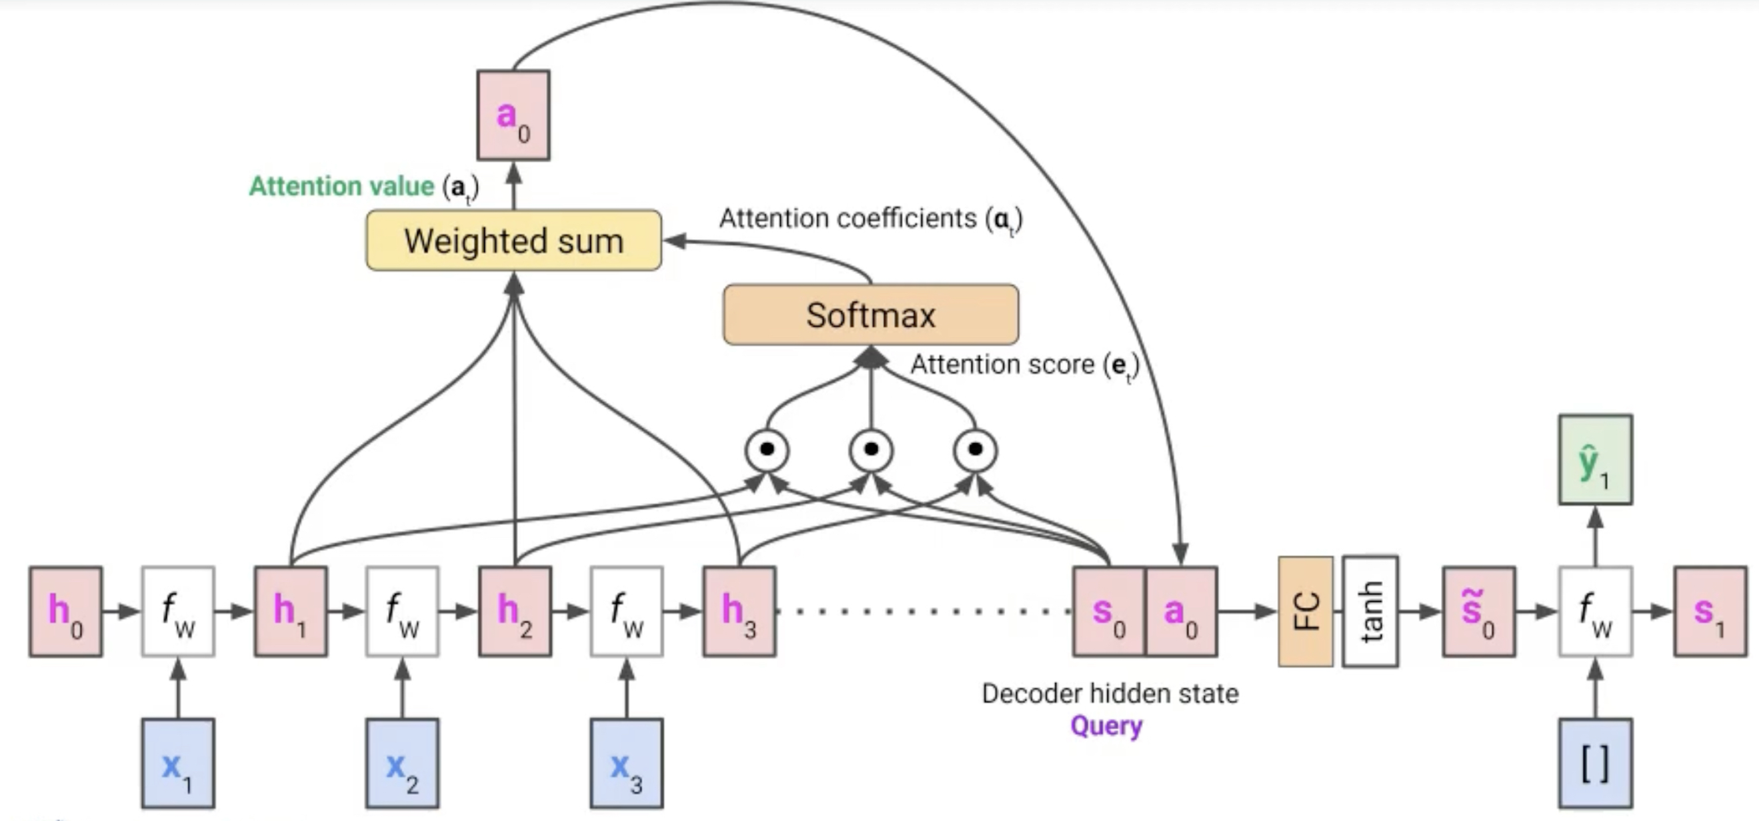
Dot-Product Attention
$a_{0}=\text{Context} \text{Vector} \text{that} \text{the} \text{decoder} \text{uses} \text{to} \text{update} \text{the} \text{next} \text{state}$
$\text{Results} \text{highlighting} \text{important} \text{information} \text{across} \text{the} \text{input} \text{data}$
The decoder uses the previous state and the context vector to predict the output word.

Slide 8
Transformer
Transformer: Rather than processing data individually, transformers learn how each element of an input sequence relates to one another.
Self-Attention Mechanism: Transformers learn how all elements of an input sequence are related to each other through a self-attention mechanism.

Slide 9
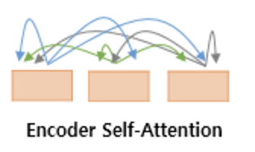
Self-Attention vs Attention
Self-Attention
Query, Key, and Value are all created from the same input data.
Query, Key, Value = Expression generated from each element of input data
Used to learn internal relationships of input data
Attention
Query and Key/Value can come from different data.
Used to learn external relationships between input data

Slide 10
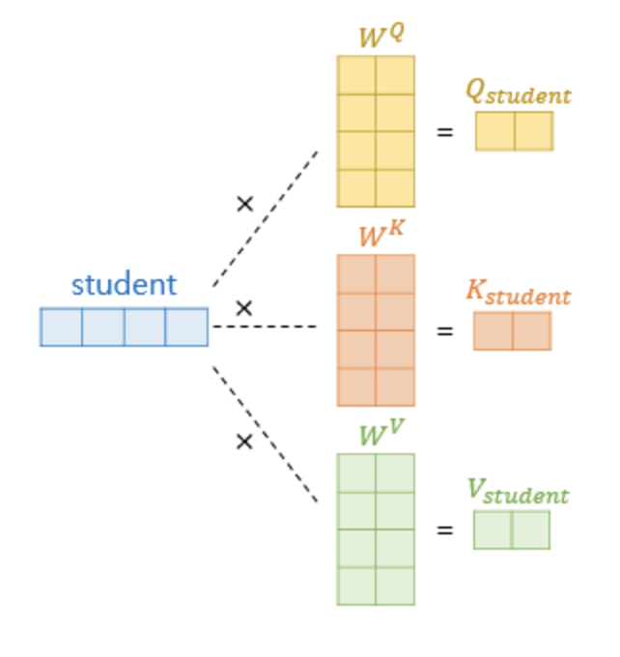
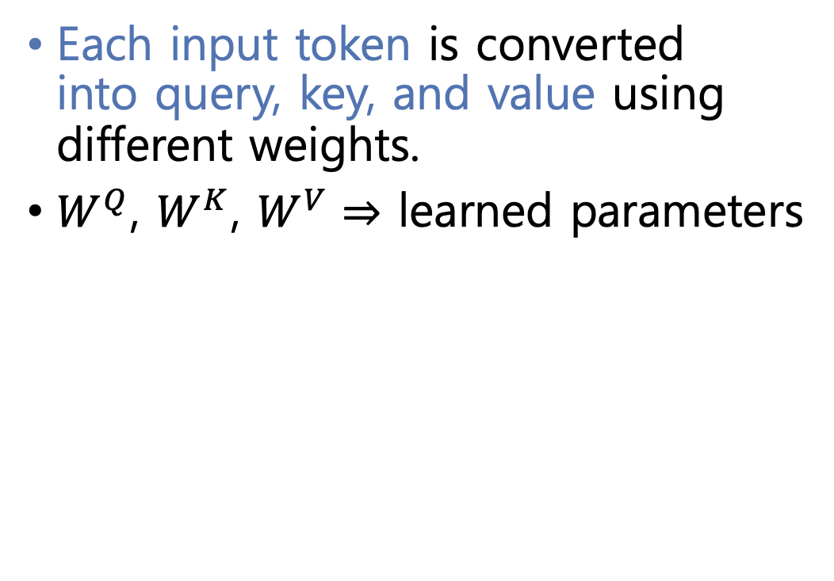
Get Q, K, V vectors
Each input token is converted into query, key, and value using different weights.
$W^{Q}$, $W^{K}$, $W^{V}⇒$ learned parameters

Slide 11
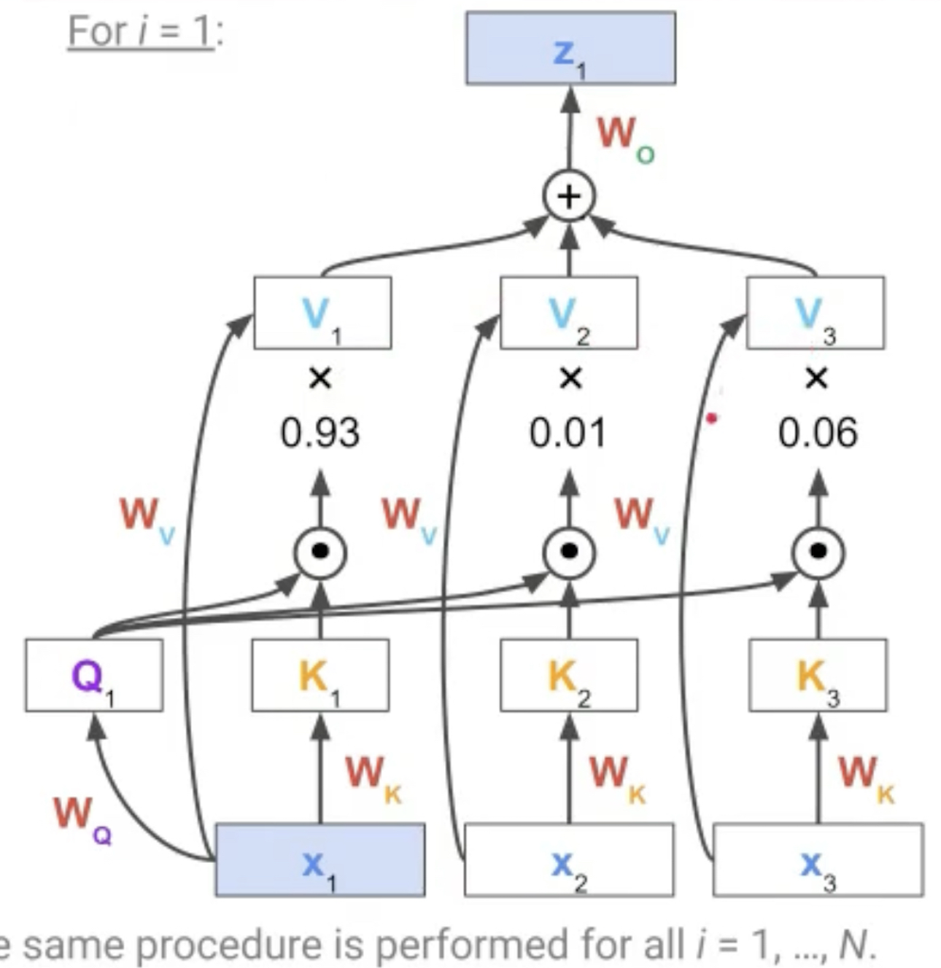
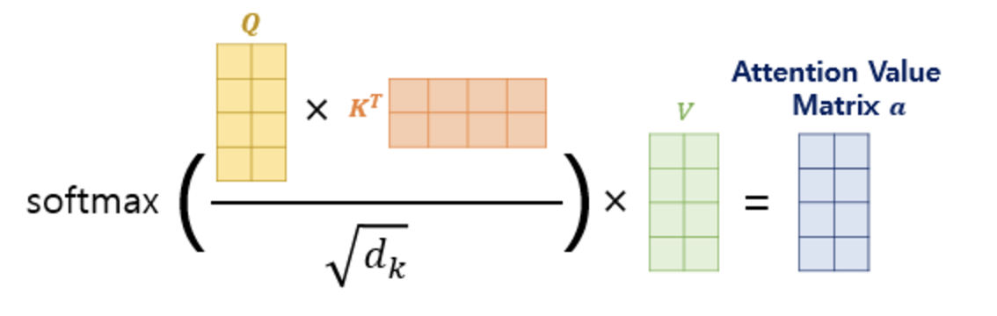
Dot-Product Attention

Slide 12
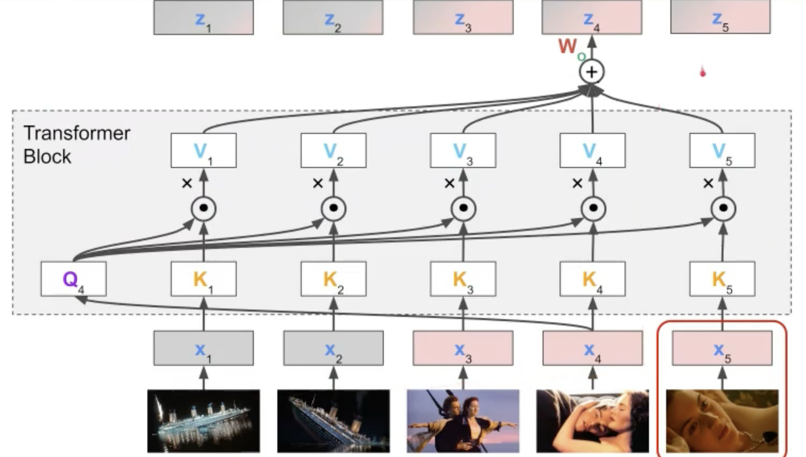
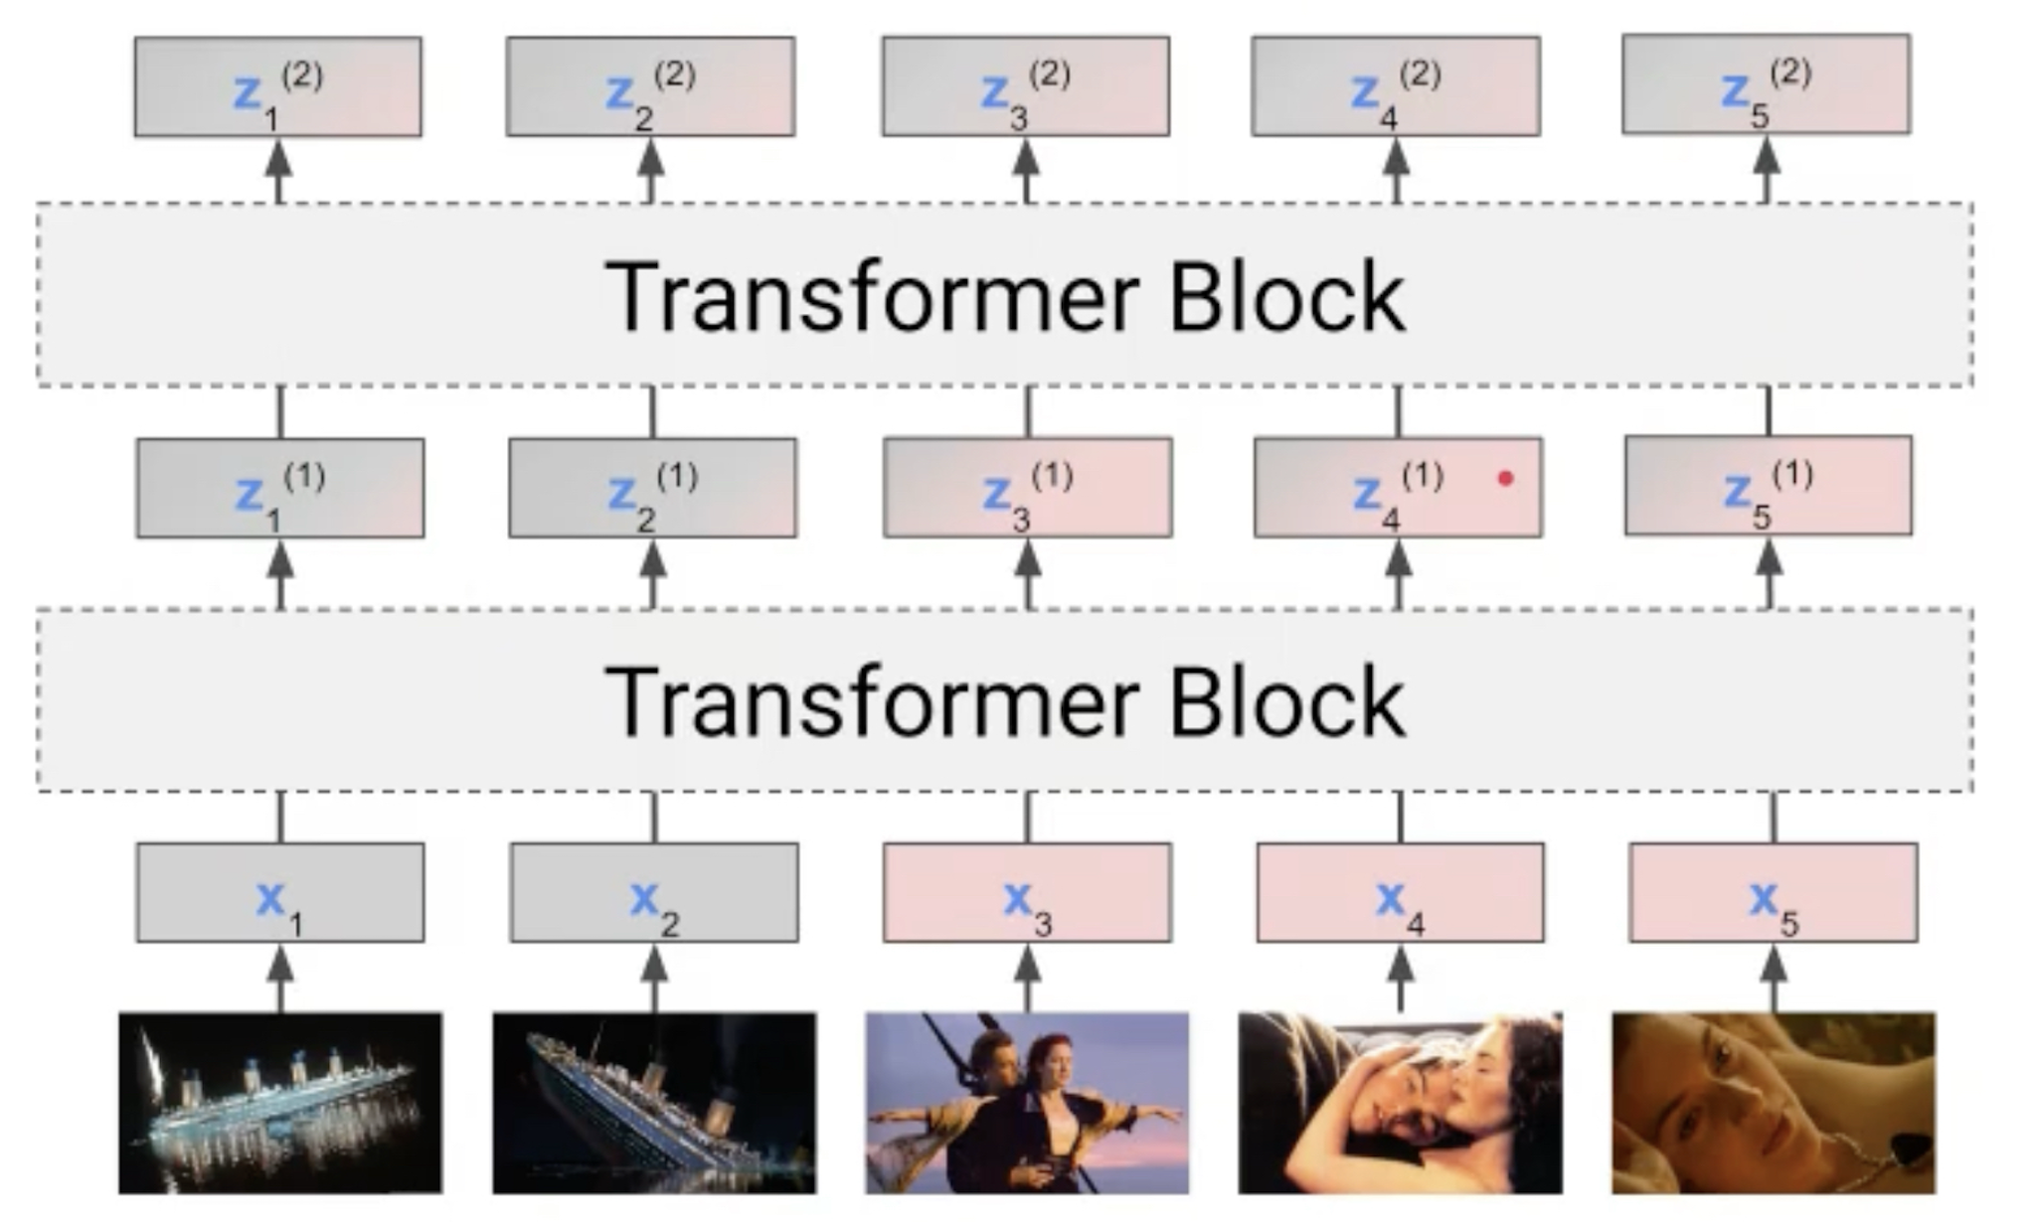
Transformer
Contextualized!

Slide 13
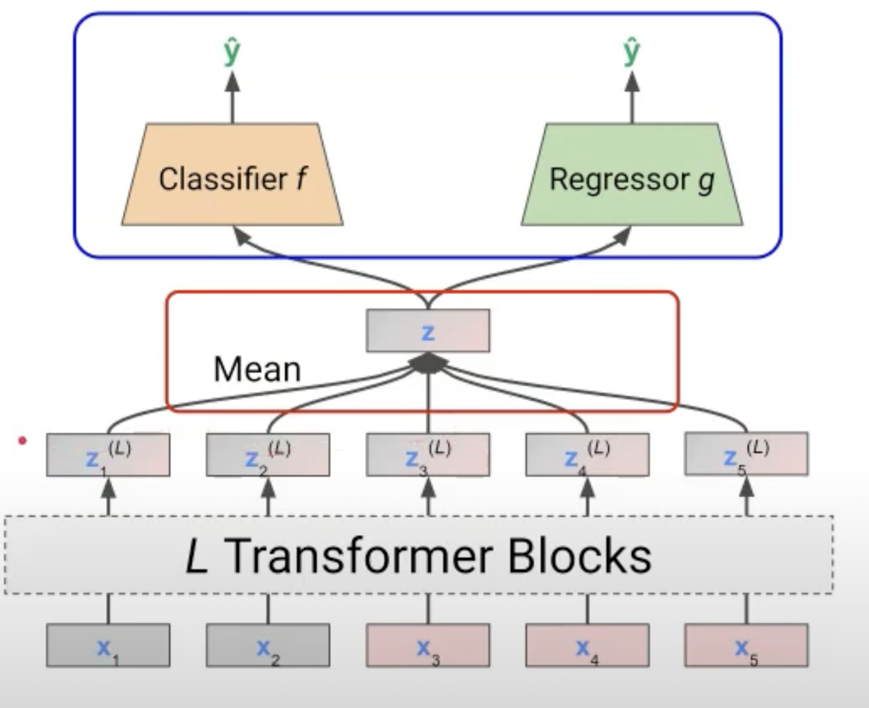
Transformer
Contextualized!

Slide 14
End

